Slide 1
Poker and AI
Zackary Medeiros

Slide 2
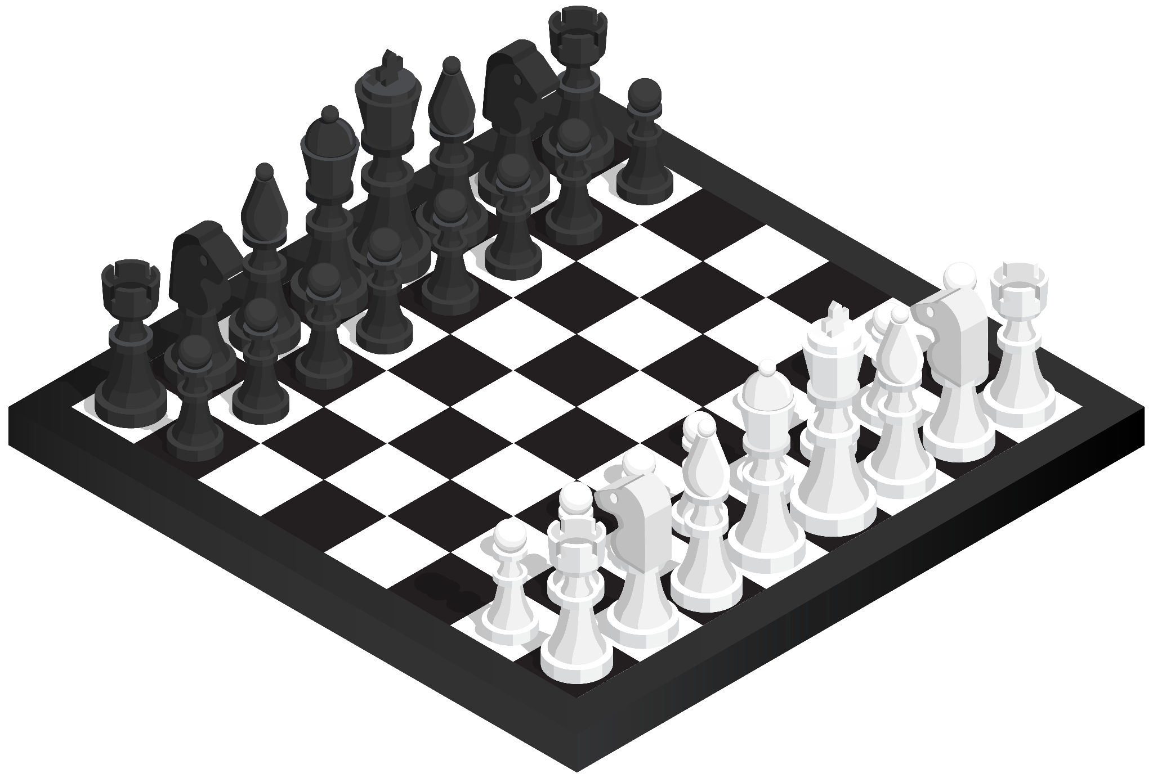
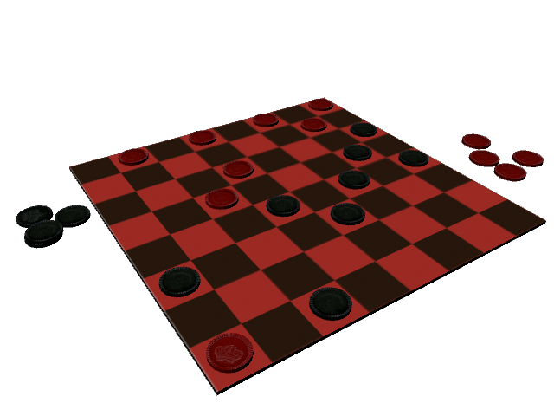
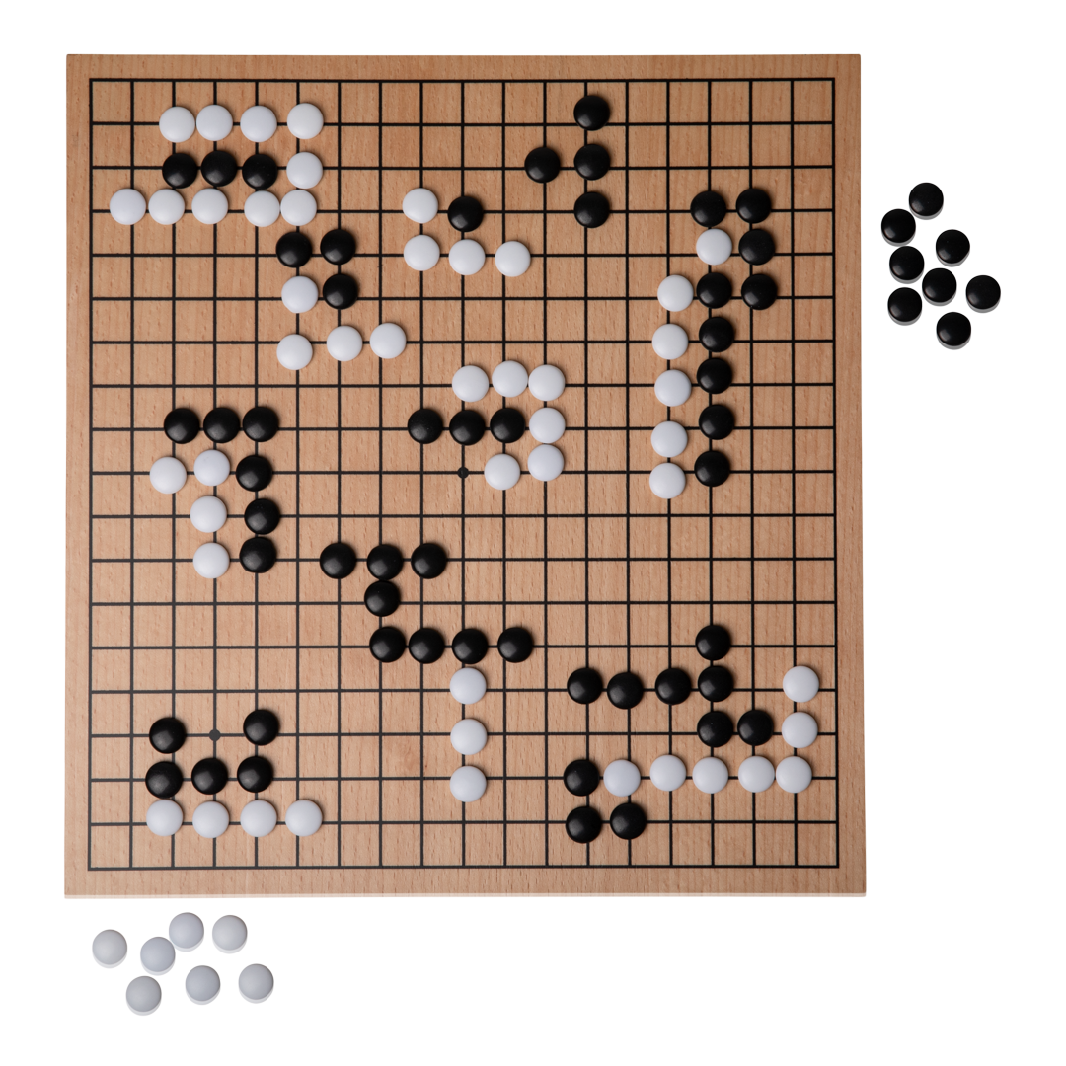
A Brief History Lesson
There have been computer ‘bots’ for games since the creation of computers themselves. The earliest AI chess players came about in the 50’s, but they weren’t very good. It wasn’t until the 90’s until AI’s began to get good at playing games.
AI solved ‘perfect information’ games such as Chess(1997), Checkers(1995), and Go(2017).
Images from Webstock Review, pngimg.com, and ubicacion de personas

Slide 3
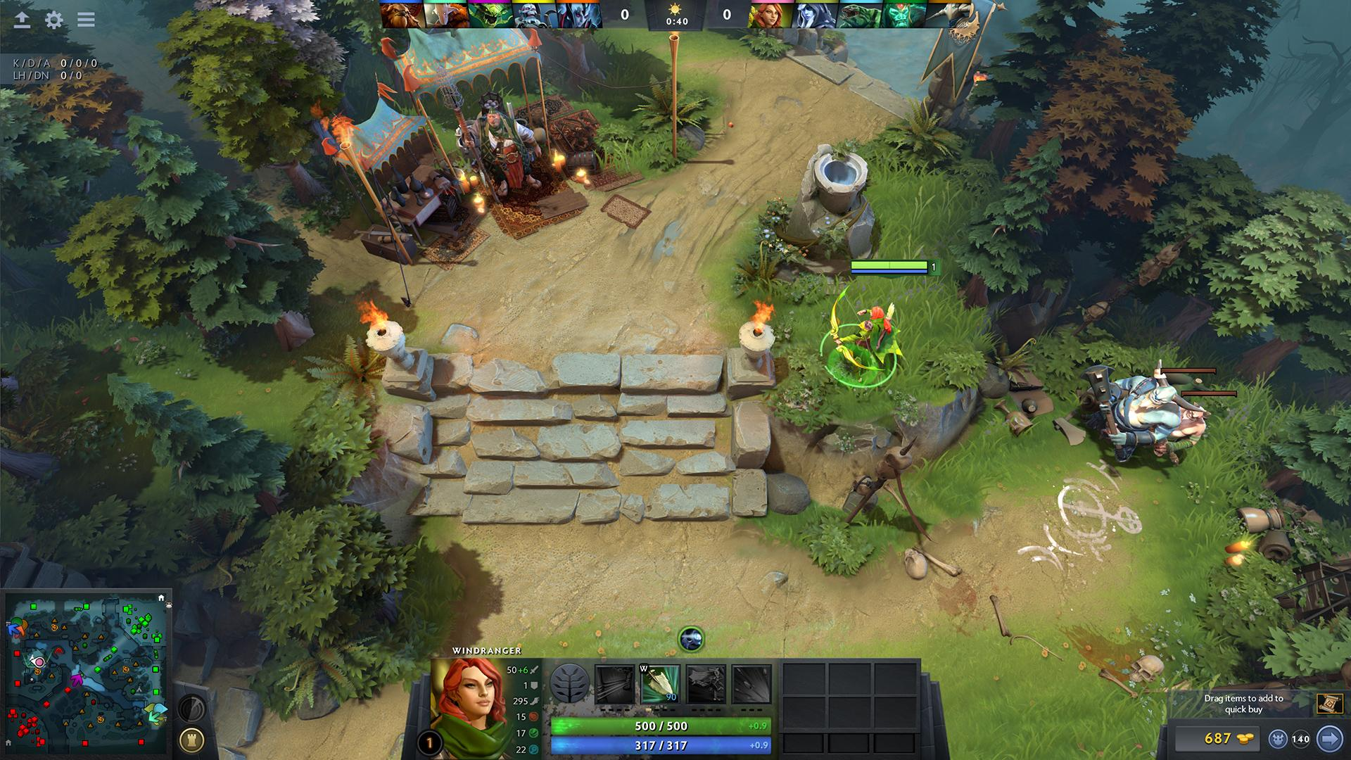
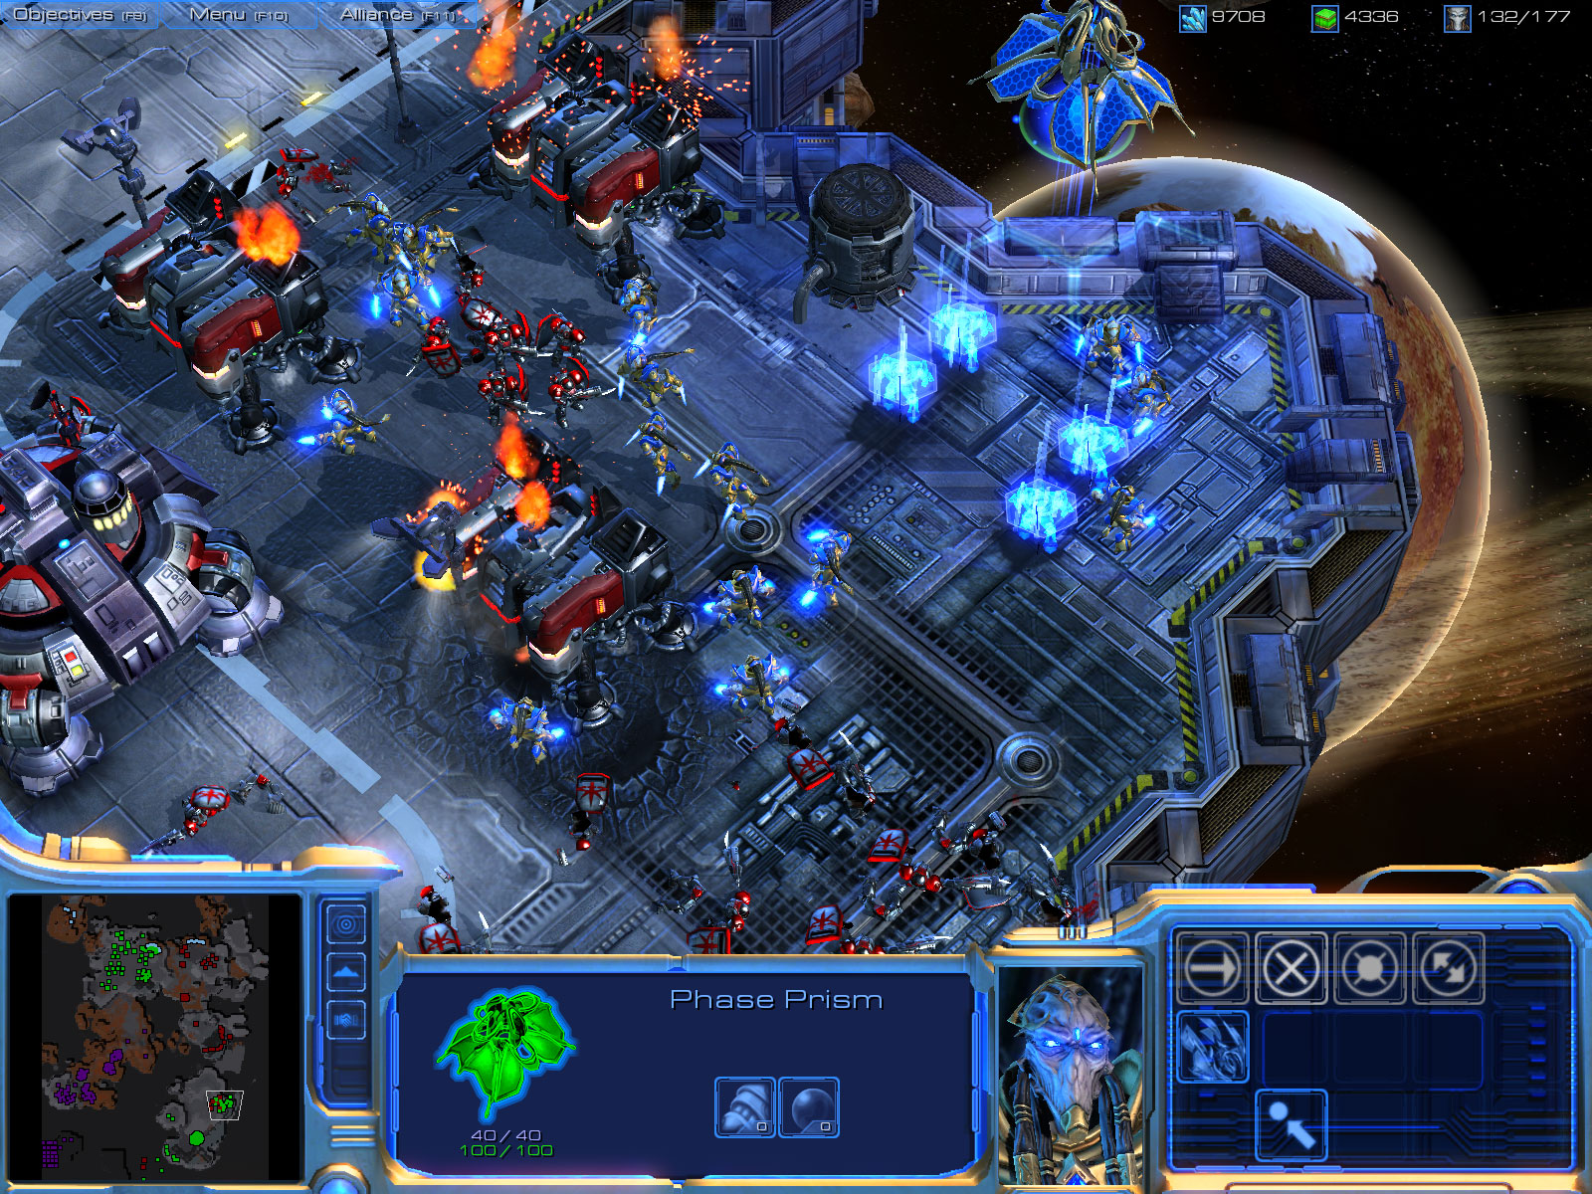
Nash Equilibrium and Solvers
“A Nash equilibrium is a situation where no player could gain by changing their own strategy”
This was the original design of game/poker solvers. Oleg Ostroumov created the first poker solver with this in mind.
The solver was used to enhance the skills of top players
Dota 2 and StarCraft 2 have also been solved. It is relatively easy to solve 2 entity (player, team) games compared to 3+ entity games.
Images from the Steam Store and Meta Games

Slide 4
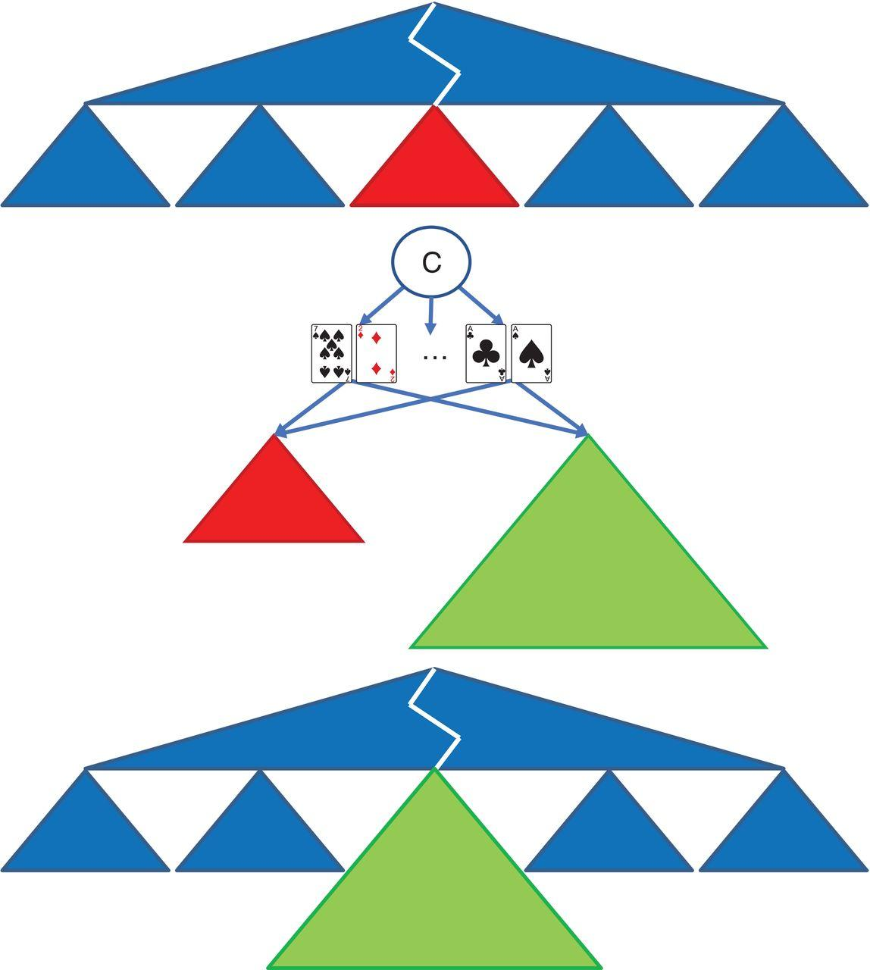
Libratus
Heads Up No Limit Texas Hold’em AI bot developed by researchers at Carnegie Mellon
Uses a three pronged approach:
Builds a blueprint strategy from an abstraction of the game
Subgame solving once the game tree is relatively small
Self improves the blueprint in real time, by filling in the game tree with more details where relevant
Image from “Superhuman AI for heads-up no-limit poker: Libratus beats top professionals”

Slide 5
Solving the game
HUNLTH is seen as solved because Libratus is unbeatable. Libratus beat professionals every time, and beat every other bot. It is not believed that a bot can do much better.
Based more on scientific proof, but elements of mathematical/computational proof are present.
Now that they solved the game, they moved on to multiplayer No Limit Texas Hold’em.
Pluribus
Innovated on Libratus, using a new depth limited strategy to search the game tree, which allows it to still be effective, even when dealing with many opponents.
Beat pros just like its predecessor. 5 person 1 bot and 5 bot 1 person were beaten by the bot.
Represents how much Heads Up was beaten, gives evidence that it was solved.

Slide 6

Why does all of this matter
Perfect information AI’s are relatively easy to develop, however they aren’t all that useful. Hidden information AI’s are highly applicable in business strategy, negotiation, strategic pricing, finance, cybersecurity, military applications, etc.. They can even take up less computing resources, because they don’t have to have a complete game tree memorized.
Image from pngplay.com

